Slide 1
Java Exception
Handling
Lab 07

Slide 2
Why Exceptions?
We seek robust programs
When something unexpected occurs
Ensure program detects the problem
Then program must do something about it
Extensive testing of special situations can result in "spaghetti code"
We need mechanism to check for problem where it could occur

Slide 3
What is an Exception?
An exception is a class used to store error information.
Exceptions are thrown in exceptional circumstances. If an exception is not caught / handled, the program terminates

Slide 4
Handling Exceptions is one of the most basic and fundamental things a developer should know by heart.
Sadly, this is often overlooked, and the importance of exception handling is underestimated - it's as important as the rest of the code.

Slide 5
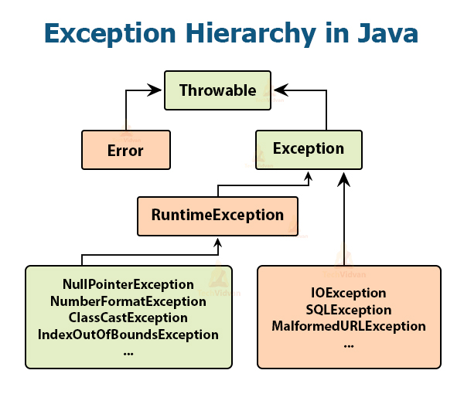

Slide 6
Java Exception Hierarchy
Superclass Throwable
Subclass Exception
Exceptional situations
Should be caught by program
Subclass Error
Examples JVM errors and resource exhaustion
Typically not caught by program
Program can’t usually recover from these

Slide 7
Java Exception Hierarchy
Unchecked exceptions
Indicate programming errors such as precondition violations
It’s your fault. Fix it!
Don’t obey Catch or declare rule.
Extend RunTimeException
Checked exceptions
Must obey Catch or Declare rule.
Should be caught by some level of program
Includes IOExceptions and any other exceptions that extend Exception but not RunTimeException.

Slide 8
Common Runtime Exceptions
java.lang. NullPointerException
java.lang. ArrayIndexOutOfBoundsException
java.lang. IndexOutOfBoundsException
java.lang. IllegalArgumentException
java.lang. ClassCastException
java.lang. ArithmeticException
java.util. NoSuchElementException
java.util. IllegalStateException
java.io. ConcurrentModificationException

Slide 9
Common Checked Exceptions
java.io. IOException
java.io. FileNotFoundException
java.net. SocketException
java.io. MalformedURLException
java.io. UnknownHostException
java.lang. InterruptedException

Slide 10
Errors
java.lang. OutOfMemoryError
java.lang. StackOverflowError
java.lang. ThreadDeath (deprecated)

Slide 11
The Catch / Declare Rule
RuntimeExceptions are unchecked exceptions.
All other Exceptions are checked exceptions.
If your method calls a checked exception, you must either:
Catch the exception and handle it, or
Declare it by adding a throws clause to your method’s header.

Slide 12
Using Exceptions
Reserved words that you need to know to use
exception handling ::
try - try this section and see what happens
catch - if the try blew up, catch the exception thrown
finally - this section always happens no matter what

Slide 13
Using Exceptions
public static void main(String args[ ])
{
int num=32;
if(num==32)
throw new Exception("num==32");
}
This code will not compile. Why not?

Slide 14
Open
exceptionone.java
exceptiontwo.java

Slide 15
Using Exceptions
public static void main(String args[ ]) throws Exception
{
int num=32;
if(num==32)
throw new Exception("num==32");
}
You have to have throws because you are throwing
a checked Exception.

Slide 16
Using Exceptions
public static void main(String args[ ])
{
int num=32;
if(num==32)
throw new RuntimeException("num==32");
}
You DO NOT have to have throws because you are throwing an unchecked Exception.

Slide 17
Open
exceptionthree.java
exceptionfour.java

Slide 18
Using Exceptions
try{
int num= 3/0;
}
//must have a catch or finally block
System.out.println("compsci");
This will not compile!!!!

Slide 19
What is an Exception?
try{
int num=3/0;
}
//catch is optional
finally{
System.out.println("divby0);
}
System.out.println("compsci");

Slide 20
Catching an exception
try { // statement that could throw an exception
}
catch (<exception type> e) {
// statements that handle the exception
}
catch (<exception type> e) { //e higher in hierarchy
// statements that handle the exception
}
finally {
// release resources
}
//other statements
At most one catch block executes
finally block always executes once, whether there’s an error or not

Slide 21
Execution of try catch blocks
For normal execution:
try block executes, then finally block executes, then other statements execute
When an error is caught and the catch block throws an exception or returns:
try block is interrupted
catch block executes (until throw or return statement)
finally block executes
When error is caught and catch block doesn’t throw an exception or return:
try block is interrupted
catch block executes
finally block executes
other statements execute
When an error occurs that is not caught:
try block is interrupted
finally block executes

Slide 22
Catch processing example
print("now");
try
{ print("is ");
throw new MyException();
print("a ");
}
catch(MyException e) { print("the "); }
print("time\n");
Prints "now is the time".
Note that exceptions don't have to be used only for error handling
Would it be a good idea to exceptions for non-error processing?
But any other use is likely to result in code that's hard to understand.

Slide 23
Multi[ple Catch Blocks
Catch blocks are checked for a match in the order that they’re listed.

Slide 24
Input / Output Exceptions
Exception
IOException
FileNotFound
Exception
MalformedURL
Exception
UnknownHostException

Slide 25
Multi[ple Catch Blocks – ORDER MATTERS!
try{
//code would go here
}
catch(Exception e){
// Code to handle all other Exceptions
}
catch(IOException e){
// Code to handle any other IO Exception
}
catch(FileNotFoundException e){
// Code to handle not finding the specified file
}
finally{
System.out.println("this always happens");
}
Notes:
The first catch block would catch ALL exceptions, so the others are never run.

Slide 26
Multi[ple Catch Blocks – ORDER MATTERS!
try{
//code would go here
}
catch(FileNotFoundException e){
// Code to handle not finding the specified file.
}
catch(IOException e){
// Code to handle any other IO Exception
}
catch(Exception e){
// Code to handle all other Exceptions
}
finally{
System.out.println("this always happens");
}

Slide 27
try{
//code would go here
}
catch(NullPointerException e){
// Code to handle the lack of a constructor
// being called.
}
catch(ClassCastException e){
// Code to handle the fact that your object
// is the wrong type.
finally{
System.out.println("this always happens");
}
Why not do this?
Runtime exceptions generally shouldn’t be caught, because they represent are programming error and should be fixed when you’re writing the code.

Slide 28
Why not do this?
try{
int i=0;
while (true) {
range[i++].climb(); }
}catch(IndexOutOfBoundsException e){
}
Don’t use exceptions for normal flow control!
Notes:
Runtime exceptions generally shouldn’t be caught, because they represent are programming error and should be fixed when you’re writing the code.

Slide 29
Why not do this?
try{
Iterator i = collection.iterator();
while (true) {
Foo foo = (Foo) i.next(); ...
}
}catch(NoSuchElementException e){}
No!
Iterator i = collection.iterator();
while (i.hasNext()){
Foo foo = (Foo) i.next(); ...
}
Yes!
Notes:
Runtime exceptions generally shouldn’t be caught, because they represent are programming error and should be fixed when you’re writing the code.

Slide 30
Don’t Ignore Exceptions
Never leave a catch block empty
try{
...
}catch(Exception e){ }
Tempting since an empty catch block won’t raise complaints from compiler.
Don’t do this!

Slide 31
Don’t Ignore Exceptions
If its empty, its highly suspect
The purpose of exception is to force programmers handle exceptional conditions
At least have a comment which explains why its ok to ignore this exception

Slide 32
Advantages of Exceptions
Separating Error-Handling Code from "Regular" Code
Propagating Errors Up the Call Stack
Grouping and Differentiating Error Types
Notes:
Exceptions provide the means to separate the details of what to do when something out of the ordinary happens from the main logic of a program. In traditional programming, error detection, reporting, and handling often lead to confusing spaghetti code.

Slide 33
Validating Method Arguments
Start a method with argument validation
Throw an exception if a test fails
Usually unchecked exceptions are thrown:
IllegalArgumentException
NullPointerException
IllegalStateException
Notes:
Exceptions provide the means to separate the details of what to do when something out of the ordinary happens from the main logic of a program. In traditional programming, error detection, reporting, and handling often lead to confusing spaghetti code.

Slide 34
Validating Method Arguments
Some common validations:
check for a null reference
check that text has visible content
check that a number is in some range
Notes:
Exceptions provide the means to separate the details of what to do when something out of the ordinary happens from the main logic of a program. In traditional programming, error detection, reporting, and handling often lead to confusing spaghetti code.

Slide 35
Validating Method Arguments
public Constructor (String name, double speed) {
if (name == null || name.trim().isEmpty()) {
throw new IllegalArgumentException(
"Name has no content.");
}
if (speed < 0.0 || speed > 1.0) {
throw new IllegalArgumentException(
"Speed not in range [0..1]: " + speed);
}
this.name = name;
this.speed = speed;

Slide 36
Document Exceptions
Checked Exceptions:
Declare (required by compiler)
And Document (with @throws tag in JavaDoc)
Unchecked Exceptions:
Document (with @throws tag in JavaDoc)
Don’t shortcut with superclass exceptions
Example: Don’t catch “Exception” instead of NullPointerException
Ok to document common exceptions at class level
Example: “All methods in class throw NullPointerException if a null object reference is passed in any parameter”

Slide 37
Open
exceptionfive.java
exceptionsix.java

